Slide 1
CS F222: Discrete Structures
for
Computer Science
Topic: Proof methods
Dr. Raghunath Reddy

Slide 2
What is a Proof ?
A proof is a valid argument that establishes the truth of a Mathematical Statement / theorem (as the conclusion)
A proof can use the hypotheses of the theorem, if any, axioms assumed to be true, and previously proven theorems.
A proof can use rules of inference.
The final step of the proof establishes the truth of the statement being proved.

Slide 3
Related Terms
Theorem: A statement that has been proven to be true.
  A statement that is considered at least somewhat important.
Lemma : A theorem that is not very important.
  We sometimes prove a theorem by a series of lemmas
Corollary : a theorem that can be easily established from a theorem that has been proved
Conjecture: a statement proposed to be a true.
  Statement, usually based on partial evidence, or intuition of an expert

Slide 4
Proof Methods for Implications
For proving implications p→q, we have:
Direct proof
Indirect proof
Vacuous proof and Trivial proof
Proof by contradiction
Proof by cases

Slide 5
Definition of a Proposition
A proposition (denoted p, q, r, …) is simply:
a statement (i.e., a declarative sentence)
  with some definite meaning, (not vague or ambiguous)
having a truth value that’s either true (T) or false (F)
  it is never both, neither, or somewhere “in between!”
    However, you might not know the actual truth value,
    and, the truth value might depend on the situation or context.
“Beijing is the capital of China.”
“1 + 2 = 3”
“It is raining.” (In a given situation.)
Today is Friday
But not,
“this sentence is false”

Slide 6
Operators / Connectives
An operator or connective combines one or more operand expressions into a larger expression. (E.g., “+” in numeric exprs.)
Formal Name | Nickname | Arity | Symbol
Negation operator | NOT | Unary | ¬
Conjunction operator | AND | Binary | ∧
Disjunction operator | OR | Binary | ∨
Exclusive-OR operator | XOR | Binary | ⊕
Implication operator | IMPLIES | Binary | →
Biconditional operator | IFF | Binary | ↔

Slide 7
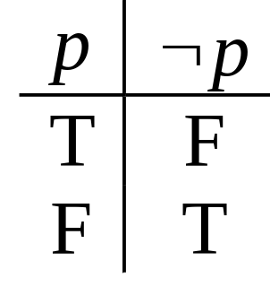
The Negation Operator
The unary negation operator “¬” (NOT) transforms a prop. into its logical negation.
E.g. If p = “I have Car”
then ¬p = “I do not have Car.”
The truth table for NOT:
Operand
column
Result
column

Slide 8
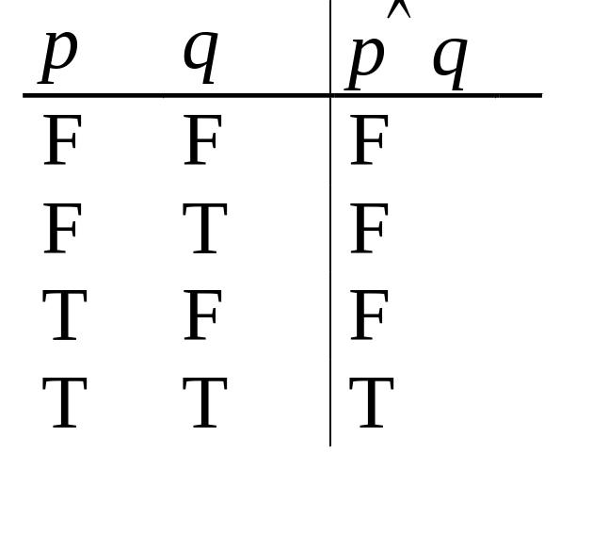
The Conjunction Operator
The binary conjunction operator “∧” (AND) combines two propositions to form their logical conjunction.
Example
If p=“I will have salad for lunch.” and
q=“I will have steak for dinner.”, then
p∧q=“I will have salad for lunch and
I will have steak for dinner.”

Slide 9
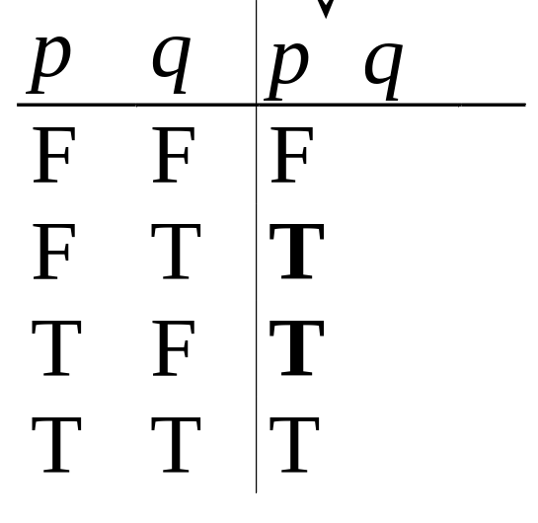
The Disjunction Operator
The binary disjunction operator “∨” (OR) combines two propositions to form their logical disjunction.
p=“My car has a bad engine.”
q=“My car has a bad carburetor.”
p∨q=“my car has a bad engine, or
my car has a bad carburetor.”

Slide 10
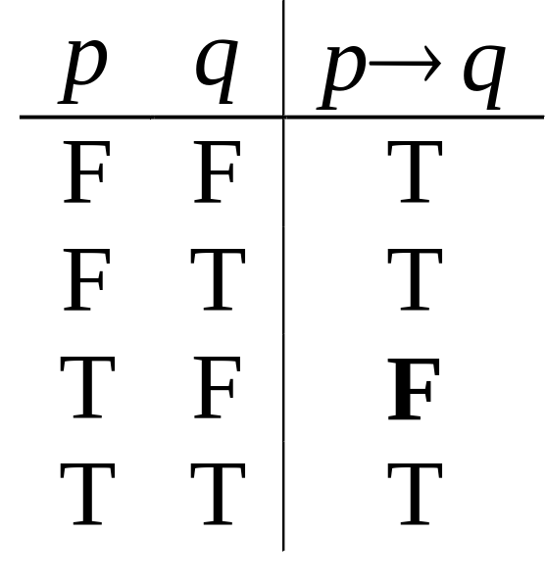
Implication
p → q reads as if p then q
(p is sufficient to happen q)
p → q is false only when
p is true but q is not true.
The
only
False
case!
“If 1+1=6, then Anna Hazare is president.”
True or False?

Slide 11
Direct Proof
A direct proof of a conditional statement
p → q
first assumes that p is true, and uses axioms, definitions, previously proved theorems, with rules of inference, to show that q is also true
The above targets to show that the case where p is true and q is false never occurs
– Thus, p → q is always true

Slide 12
Direct Proof (Example)
Show that if m and n are both perfect square numbers, then mn is also a perfect square number.

Slide 13
Proof by contraposition (indirect proof)
The proof by contraposition method makes use of the equivalence
p → q ≡ ¬ q → ¬ p
To show that the conditional statement p → q is true, we first assume ¬ q is true, use axioms, definitions, proved theorems, with rules of inference, and show that ¬ p is also true

Slide 14
Proof by contraposition (Example)
Show that if 3n + 2 is an odd integer, then n is odd.
Proof :

Slide 15
Vacuous Proofs
Given a statement p → q,
  If we can prove that p is false, then we conclude that p → q is true. This is called vacuous proof.
Example:
Prove that if n is an integer with 10 ≤ n ≤ 15 which is a perfect square, then n is also a perfect cube.

Slide 16
Trivial Proofs
A proof of p → q that uses the fact that q is true is called a trivial proof
Example:

Slide 17
Proof by contradiction
The proof by contradiction method makes use of the equivalence
p ≡ ¬ p → F₀ where F₀ is any contradiction
One way to show that the latter is as follows: First assume ¬ p is true, and then show that for some proposition r, r is true and ¬ r is true
That is, we show ¬ p → ( r ∧ ¬ r ) is true

Slide 18
Proof by contradiction (example)
Show that √ 2 is irrational.
Proof :
Assume on the contrary that it is rational. Then it can be expressed as a / b, for some positive integers a and b with b ≠ 0.
Further, we may restrict a and b to have no common factor.
It follows that a² = 2b² so that a is even.

Slide 19
Proof cont…
Then a = 2c for some integer c, so that
(2c)² = 2b² .
It follows that b² = 2c² so that b is even.
A contradiction occurs (where ?), so that the original statement is true.

Slide 20

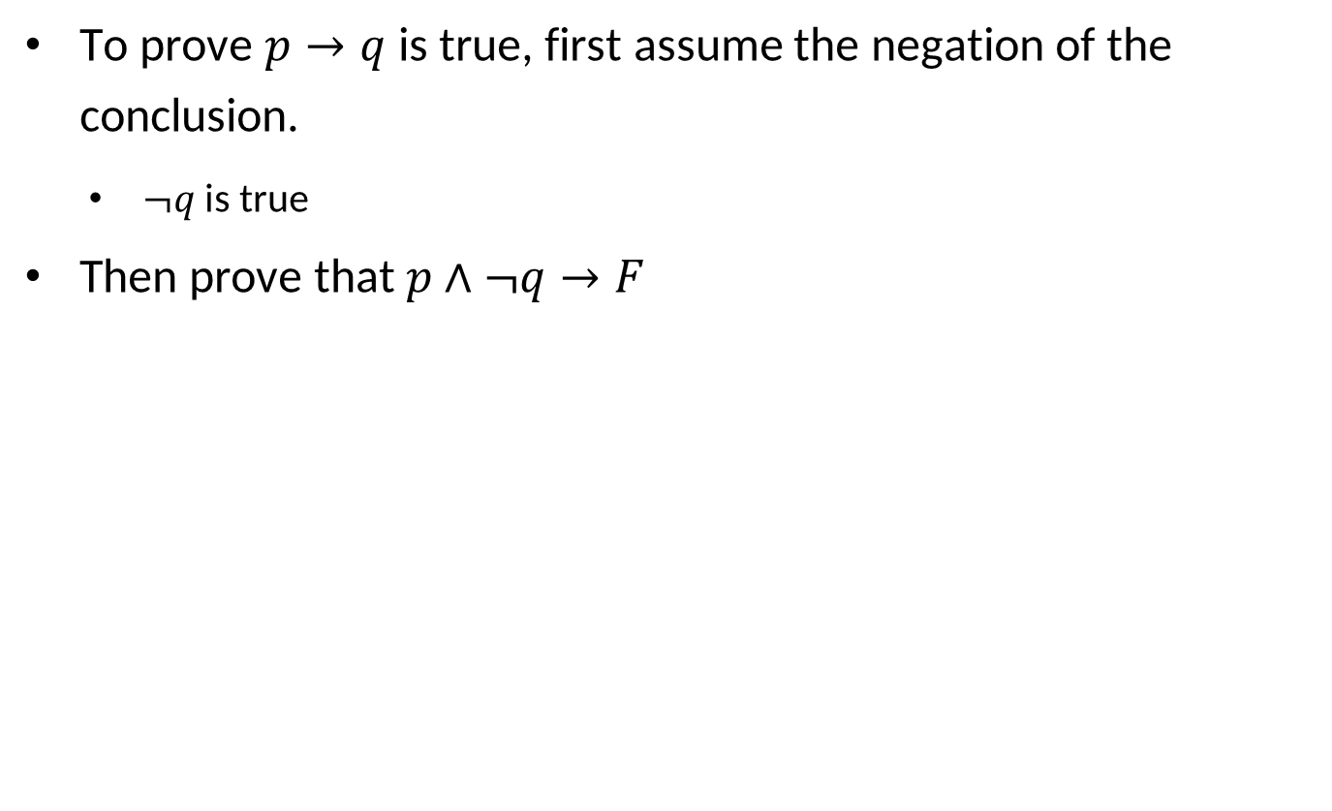

Slide 21
Proof of contraposition as proof of contradiction
proof of p → q by contraposition:
  we assume that ¬q is true.
  We then show that ¬p must also be true.
Rewrite as proof of contradiction:
  we suppose that both p and ¬ q are true.
  Then, we use the steps from the proof of ¬ q → ¬ p to show that ¬ p is true.
  This leads to the contradiction p ∧ ¬p, completing the proof.

Slide 22
Example:
Prove that “if 3n + 2 is odd, then n is odd”.
Proof:

Slide 23
Proof by cases
The proof by cases method makes use of the equivalence
( p₁ ∨ p₂ ∨ … ∨ p_{k} ) → q ≡ ( p₁ → q ) ∧ ( p₂ → q ) ∧ … ∧ ( p_{k} → q )
Sometimes, to prove p → q is true, it may be easy to use an equivalent disjunction p₁ ∨ p₂ ∨ … ∨ p_{k} instead of p as the hypothesis

Slide 24
Proof by cases (Example)
Show that if an integer n is not divisible by 3, then n² = 3k + 1 for some integer k.
Proof :
“n is not divisible by 3” is equivalent to
  “n = 3m + 1 for some integer m” or
  “n = 3m + 2 for some integer m”.
If it is the first case :
  n² = (3m + 1)² = 9m² + 6m + 1 = 3(3m² + 2m) + 1 = 3k + 1 for some k.
If it is the second case :
n² = (3m + 2)² = 9m² + 12m + 4 = 3(3m² + 4m + 1) + 1 = 3k + 1 for some k.

Slide 25
Proof of Equivalence
When proving bi-conditional statement, we may make use of the equivalence
p ↔ q ≡ ( p → q ) ∧ ( q → p )
In general, when proving several propositions are equivalent, we can use the equivalence
p₁ ↔ p₂ ↔ … ↔ p_{k} ≡ ( p₁ → p₂ ) ∧ ( p₂ → p₃ ) ∧ … ∧ ( p_{k} → p)

Slide 26
Proof of Equivalence (Example)
Show that the following statements about the integer n are equivalent :
p := “n is even”
q := “n – 1 is odd”
r := “n² is even”
To do so, we can show the three propositions
p → q, q → r, and r → p are all true.

Slide 27
Existence Proofs
A proof of the proposition of the form ∃x P(x) is called an existence proof
Sometimes, we can find an element, called a witness, such that P(s) is true
  This type of existence proof is constructive
Example: Show that there is a positive integer that can be written as the sum of cubes of positive integers in two different ways.

Slide 28
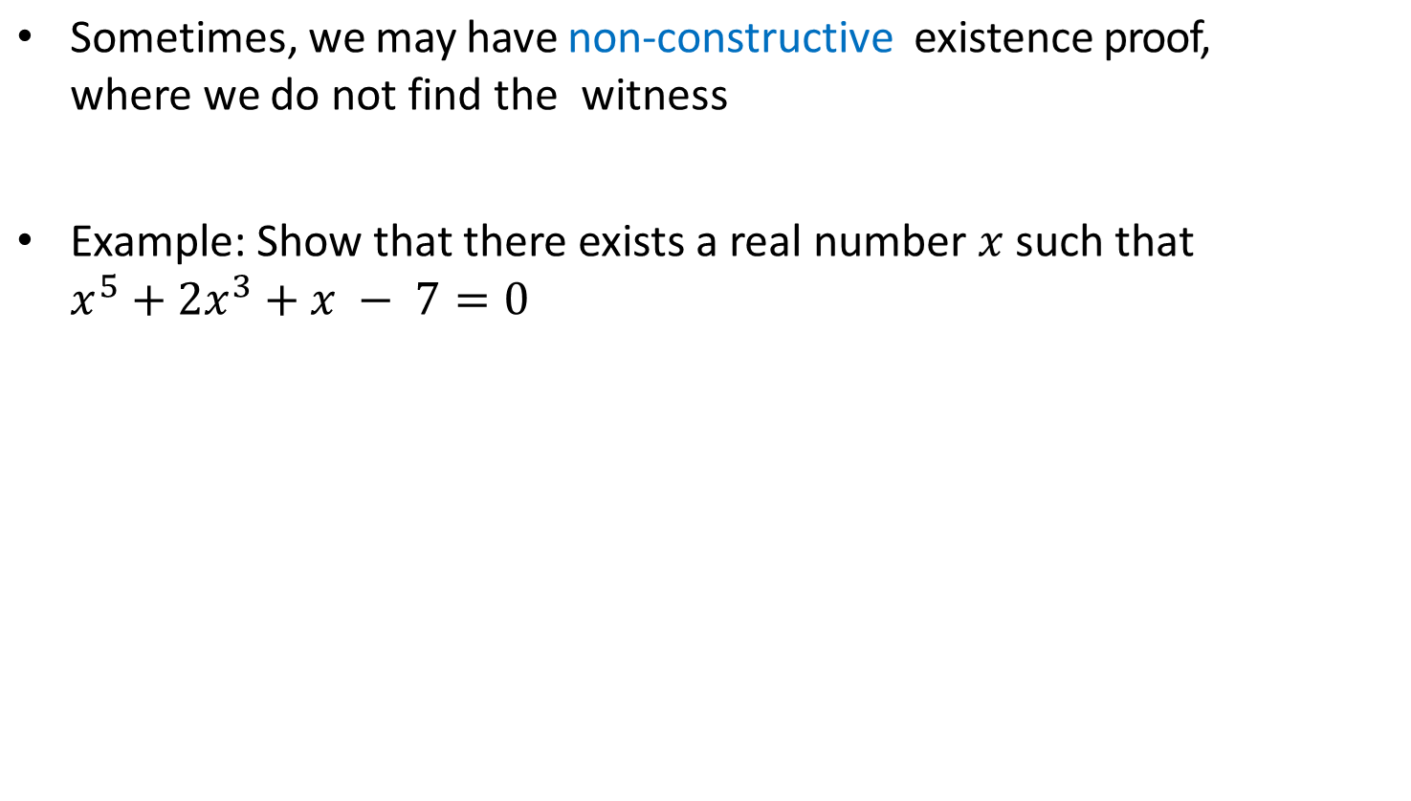
Existence Proofs

Slide 29
Common Fallacies
A fallacy is an inference rule or other proof method that is not logically valid.
  A fallacy may yield a false conclusion!
Fallacy of affirming the conclusion:
  “p→q is true, and q is true, so p must be true.” (No, because F→T is true.)
Fallacy of denying the hypothesis:
  “p→q is true, and p is false, so q must be false.” (No, again because F→T is true.)

Slide 30
Thank You!!

